Slide 1

PLANNING
MGN-502
Lecture - 1
“Todays’ projection for Tomorrow’s activity”

Slide 2

Faculty Details
01
Course Instructor: Mr. P. B. Narendra Kiran (UID 28647)
Designation: Assistant Professor
Contact : 9182559741
Email: narendra.28647@lpu.co.in

Slide 3
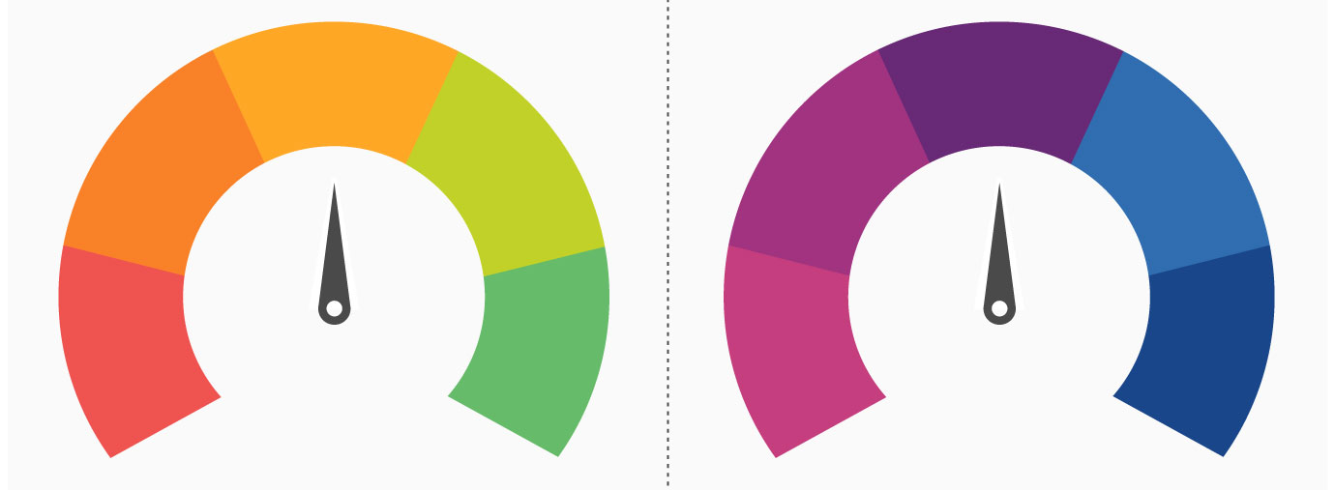
Introduction
02
“Planning” is the first step of management process concerned with the establishment of objectives and analysis of present limitations for attaining such goals
Defined as thinking in advance, bridges gap between where we are and where we want to go

Slide 4
About Planning
03
A Plan is like a map, A pre-determined course of action.
- what is to be done, - when it is to be done,
- how it is to be done, - by whom it is to be done
- Where is it to be carried
Planning involves setting objectives and deciding in advance the appropriate course of action
to achieve these objectives. So we can also define planning as setting up of objectives and targets
and formulating an action plan to achieve them.

Slide 5
Author’s definitions for Planning
04
“Planning is an intellectually demanding process; it requires conscious determination of course of action and basing of directions on purpose, knowledge and considered estimates.”
- Koontz O’Donnell
“Planning is the conscious selection and developing the best course of action to accomplish an objective. It is the basis from which the future management action spring.”
- Mary Cushing Niles
“Planning is the selecting and relating of facts and the making and using of assumptions regarding the future in the visualization and formulation of proposed activites, believed necessary to achieve the desired results.”
- George R Terry

Slide 6

Features/Nature/Characteristics of Planning
05
Planning focuses on achieving objectives
Planning is primary function of management
Planning is pervasive
Planning is continuous
Planning is futuristic
Planning facilitates decision making
Planning is a mental exercise

Slide 7
Features of a Good Plan
06
According to L F Urwick, a good plan should contain
A clear goal
Be Simple
Be Amenable for proper analysis and classification of actions
Be Flexible
Be Balanced
Should provide Optimum use of resources

Slide 8
Types of Plans
07
According to time dimension:
Short term : Up to one year
Medium Term : 1 – 5 years
Long term : >5 years

Slide 9
TYPES OF PLANS Made Under Base of
08
Objectives/goals
Strategies & tactics
Standards
Budgets
Policies
Procedures
Programmes
Rules
Methods

Slide 10
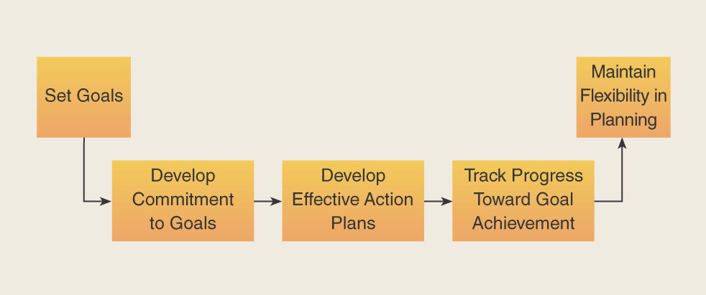
How to Make a Plan That Works
09

Slide 11
Setting Goals
10
Specific
Measurable
Attainable
Realistic
Timely

Slide 12
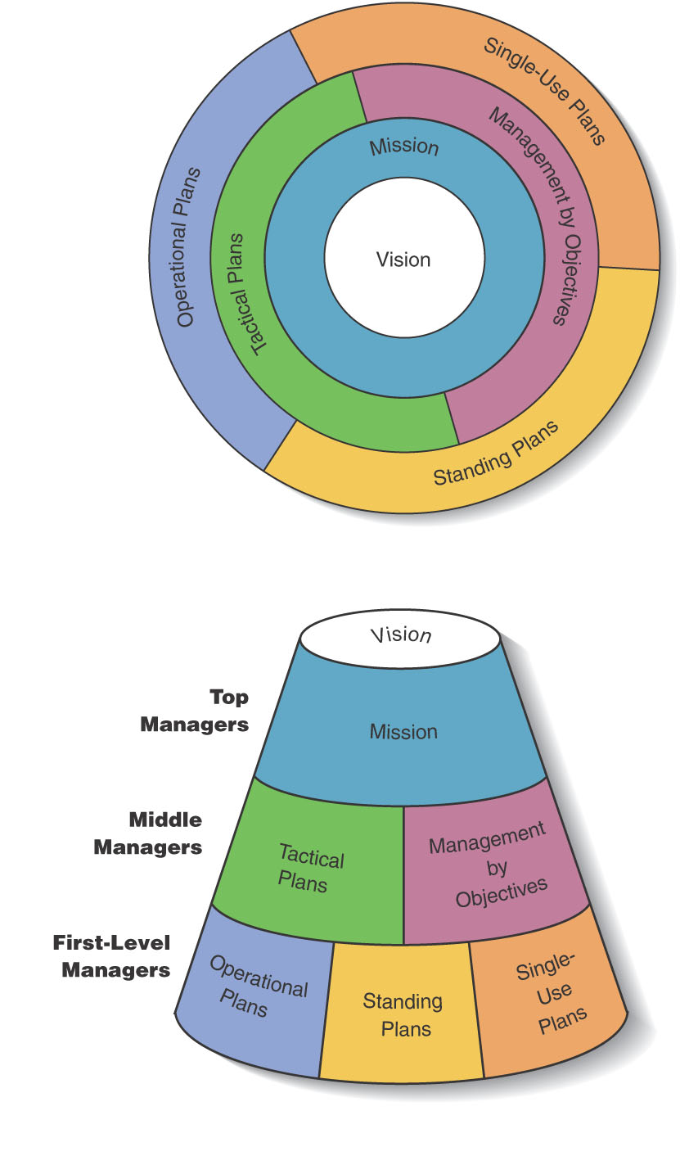
Type of Plans with Organisational Vision & Mission
11

Slide 13
Planning From Top to Bottom
12

Slide 14
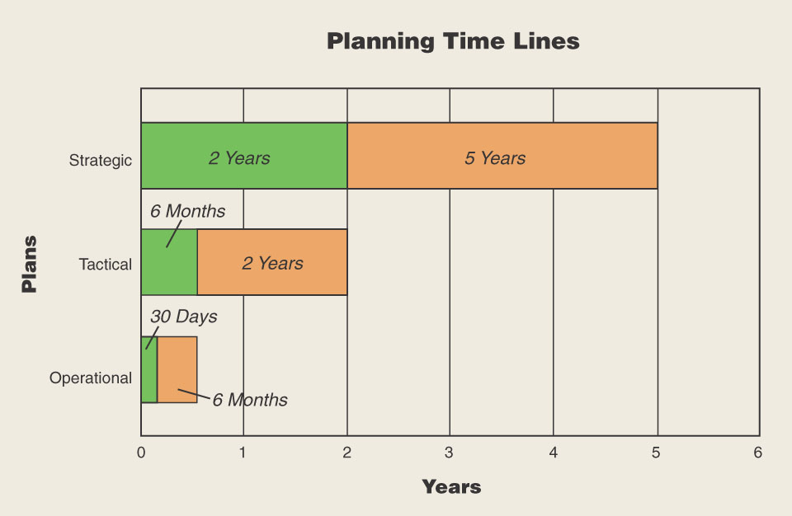
Planning Timeframes
13

Slide 15

Process of Planning: (S DIES IF)
14
Planning Process
Setting Objectives
Developing Premises
Identifying alternative courses of action
Evaluating alternative courses
Selecting an alternative
Implementing the Plan
Follow-up action

Slide 16
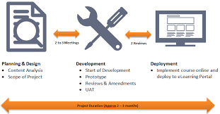
Importance of Planning
15
Planning provides directions
Planning reduces the risks of uncertainty
Planning reduces overlapping and wasteful activities
Planning promotes innovative ideas
Planning facilitates decision making
Planning establishes standards for controlling

Slide 17
Limitations of Planning
16
Planning leads to rigidity
Planning may not work in a dynamic environment
Planning reduces creativity
Planning involves huge costs
Planning is a time consuming process
Planning does not guarantee success

Slide 18

Essential elements of Planning
17
Forecasting : It is the starting point of planning on which the business misses its course of action forecasting can be described as the projection of present trains into the future.
Objective : Objectives determine the goal or end results of projected actions.
Policies : Policy is a written statement or some oral understanding in general term which govern the action of subordinate in similar situations.
Procedures : Procedures indicate as to how a particular activities to be performed. Procedure is a fixed path through the defined area of policy.

Slide 19
Essential elements of Planning
18
Continue…..
Programmes : For a complete and ordinary course of action programmes are laid down within the framework of the plans.
Rules : Rules are prescribed guides to action day of unknown discretion to employees. They specify what should be done and what should not be done.
Budgets : Budgets and numerical statement prepared for a particular period budgets are generally prepared in terms of money but other units may also be used that set standard from which actuals can be compared.
Strategies : Strategies are modified plans or policies to meet a particular situation particularly competitive situation in the market.

Slide 20
Planning for Change
19
Stretch goals
Extremely ambitious goals that you don’t know how to reach
Benchmarking
Identifying outstanding practices, processes, and standards in other companies
Adapting them to your company

Slide 21
Planning for Contingencies: Scenario Planning
20
Define the scope of the scenario
Identify the major stakeholders
Identify environmental trends
Identify key uncertainties and outcomes
Using steps 1-4 create initial scenarios
Check each scenario for consistency and plausibility of facts
Create contingency plans from each scenario
Develop measures to indicate when scenario events are occurring

Slide 22
Thank you

